Slide 1
PhoneGap and Xamarin: Your Excuse to Not Write Your Mobile App is Gone
Jerrel Blankenship & Jamie Dicken

Slide 2
Who We Are
Jerrel Blankenship
@TheJerrel
Software Engineer at RelayHealth
Author: Pro Agile .NET Development with Scrum
Striving Software Craftsman
Certified Scrum Master
Jamie Dicken
@DotNetGeekette
Software developer and team lead at McKesson-RelayHealth
Mobile enthusiast
Volunteer at Per Scholas

Slide 3

Which One Do I Choose?

Slide 4
Frameworks To The Rescue
PhoneGap
Xamarin
AppMobi
Unity
Appcelerator
Adobe Flex

Slide 5
PhoneGap

Slide 6
What Is PhoneGap?
Open-source
Single codebase
Support for iOS, Android, Windows Phone, Blackberry, webOS

Slide 7
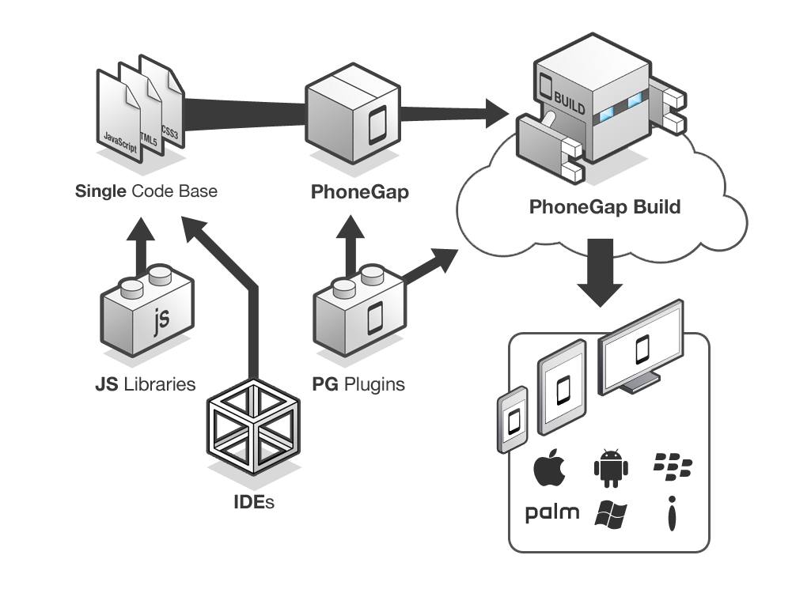
PhoneGap Overview
Notes:
Essentially, this is what the PhoneGap application creation process looks like. You take your IDE of choice as well as the javascript libraries you know and love, like jQuery mobile. You create one codebase, thereby eliminating the maintenance nightmares we face with redundant codebases. You wrap your html, css, and javascript files with PhoneGap, and you can take advantage of the PhoneGap plugins that interact with your device’s capabilities, like the camera and geolocation services. You send your app to PhoneGap build, and you end up with ready-to-submit app packages for each of the target platforms.

Slide 8
Let’s Create an App!

Slide 9
Xamarin

Slide 10
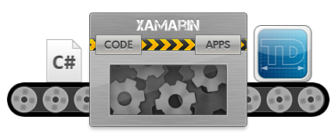
Xamarin Details
Cross-platform development with C#
Create native apps using Native APIs
Use any existing .NET Libraries
Notes:
Xamarin contains a fully functional implementation of the .NET runtime, called Mono, which is bundled with your app so that your code executes with all of the power of C# and .NET, including memory management, reflection, and the .NET base class libraries
Can develop Android and iOS apps
iOS requires network connection to Mac
Xamarin's binding technology exposes all of the APIs available in iOS and Android to your applications as regular C# class libraries.
This means your Xamarin application can do anything a platform, or device, offers, with native user interface and excellent performance.
Xamarin compiles your app to a native binary, not cross-compiled, and not interpreted.
Visual Studio Integration

Slide 11
Let’s Create an App!

Slide 12
PhoneGap v. Xamarin: Which do I choose?
Notes:
Jamie: Now that we’ve shown you two tools for cross-platform mobile development, the question becomes “which one should I use?”
Jerrel: Clearly, both of these tools allow you to easily create an app to deploy to all of the major app stores, so it really comes down to what you’re trying to accomplish.
Jamie: Let’s take a look at the advantages and disadvantages of each.

Slide 13
Key Considerations
Cost
Performance
Supported platforms
Native app experience

Slide 14
Questions?
Notes:
Jamie: Well, there you have it – two very different tools for creating cross-platform mobile applications. One leverages your web skills of HTML, CSS, and Javascript. The other allows you a cleaner way to have a different user interface per platform, easily making your apps seem much more targeted per environment and therefore enhancing the user experience.
Jerrel: And with that, your excuse to not write your mobile app is gone!

Slide 15


Slide 16
Contact Us
Jerrel Blankenship
Jerrel@jerrelblankenship.com
@TheJerrel
www.jerrelblankenship.com
Jamie Dicken
Jamie@dotnetgeekette.com
@DotNetGeekette
www.dotnetgeekette.com
Slide Deck Link:
http://bit.ly/16wOVaP

Slide 17
Image Attributions
Diagram - PhoneGap Overview by Adobe / Yohei Shimomae
Diagram - PhoneGap Build by Adobe / Yohei Shimomae
Smart Phone, Tablet, and PC – The Droid Guy

Slide 18
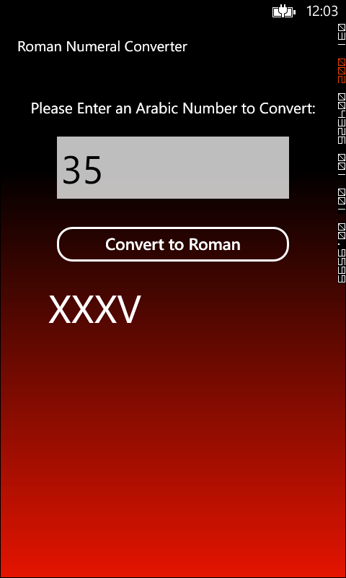
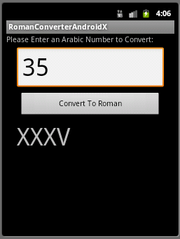
Xamarin App Comparison
Windows Phone 8
Android

